Slide 1

Welcome to ECSTRA –
Era’s Center for Start-Up Training, Research and Acceleration
Empowering Innovation in Healthcare and Medical Education
Founder & CEO – Zaw Ali Khan

Slide 2
Table of contents
01
About ECSTRA
02
The ECSTRA Ecosystem
03
Services we provide
04
Our programs & trainings
05
Get Involved / Contact Us

Slide 3


Era’s Center for Start-Up Training, Research and Acceleration
Vision:
Improve healthcare and education in India and abroad for enhanced quality of care
Mission:
To Improve healthcare outcomes by equipping patients, healthcare workers and students with solutions that reduce HCW burnout and eliminate medical errors
“ECSTRA is an incubation center focused on transforming healthcare and medical education through innovation. With a mission to reduce healthcare worker burnout and eliminate medical errors, ECSTRA supports tech-driven startups with mentorship, infrastructure, funding access, and a strong network. Our goal is to build a thriving ecosystem that empowers solutions for better care and learning—both in India and globally.”
Zaw Ali Khan
Founder & CEO

Slide 4



We have build a thriving ecosystem that empowers solutions for better care and learning
Clinical infrastructure
OTs, radiology, emergency, radiotherapy wellness ward etc. for clinical emersion at Era Lucknow Medical College and Hospital
Doctors and healthcare workforce for clinical expertise
Technical Infrastructure
Bio-medical workshop
Eras Medical Devices fabrication facility
Gaming and Animation Lab
SHIFT innovation center
Digital factory for software development
Pool of innovators, mentors & investors
Internal and external experts form diverse backgrounds willing to support healthcare innovations (management, technical)

Slide 5






Empowering innovators with training, clinical exposure and collaborative support for developing impactful healthcare solutions
Innovation Tools and Methodologies
Funding Guidance and Support
Mentorship from experts: workshop and training sessions
Clinical Emersion
Networking opportunities with healthcare professionals and investors
POC Development Support

Slide 6

Our programs & trainings
ECSTRA
Programs
Types of programs and Trainings
Pre Incubation Program
ECSTRA Fellowship Program
Self sponsored
Start-up residency/virtual incubation
Startups are provided with:
Co-working space
Access to infrastructure
Mentor pool
Funding support
Networking opportunities
Incubation Program

Slide 7






We are continuously expanding our partner ecosystem

Slide 8
Contact Us!
Zaw Ali Khan
Founder & CEO
Phone: +91 XXXXXXXX
zawali@erauniversity.in
Era’s Center for Start-Up Training, Research and Acceleration - ECSTRA
Tondan Marg, Sarfarazganj
Lucknow 226003, Uttar Pradesh
India
Phone
ecstra@erauniversity.in
https://erauniversity.in/ecstra/

Slide 9
Era’s Center for Start-Up Training, Research and Acceleration
Vision:
Improve healthcare and education in India and abroad for enhanced quality of care
Mission:
To Improve healthcare outcomes by equipping patients, healthcare workers and students with solutions that reduce HCW burnout and eliminate medical errors
“ECSTRA is an incubation center focused on transforming healthcare and medical education through innovation. With a mission to reduce healthcare worker burnout and eliminate medical errors, ECSTRA supports tech-driven startups with mentorship, infrastructure, funding access, and a strong network. Our goal is to build a thriving ecosystem that empowers solutions for better care and learning—both in India and globally.”
Zaw Ali Khan
Founder & CEO

Slide 10
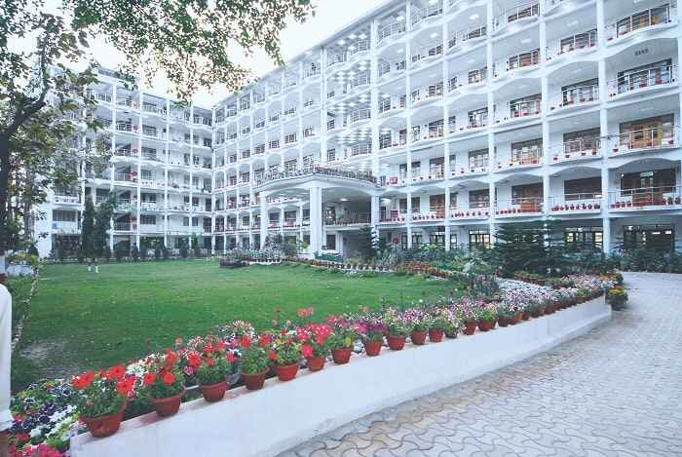
Era’s Center for Start-Up Training, Research and Acceleration
Vision:
Improve healthcare and education in India and abroad for enhanced quality of care
Mission:
To Improve healthcare outcomes by equipping patients, healthcare workers and students with solutions that reduce HCW burnout and eliminate medical errors
“ECSTRA is an incubation center focused on transforming healthcare and medical education through innovation. With a mission to reduce healthcare worker burnout and eliminate medical errors, ECSTRA supports tech-driven startups with mentorship, infrastructure, funding access, and a strong network. Our goal is to build a thriving ecosystem that empowers solutions for better care and learning—both in India and globally.”
Zaw Ali Khan
Founder & CEO

Slide 11

We have build a thriving ecosystem that empowers solutions for better care and learning
Eras Lucknow Medical College and Hospital
Clinical infrastructure (OTs, radiology, emergency, radiotherapy wellness ward etc.) for clinical emersion
Doctors and healthcare workforce for clinical expertise
Technical Infrastructure
Bio-medical workshop
Eras Medical Devices fabrication facility
Gaming and Animation Lab
SHIFT innovation center
Digital factory for software development
Pool of mentors
Internal and external experts form diverse backgrounds willing to support healthcare innovations (management, technical)

Slide 12

Empowering innovators with training, clinical exposure and collaborative support for developing impactful healthcare solutions
Mentorship from experts: workshop and training sessions
Networking opportunities with healthcare professionals and investors
POC Development Support
Clinical Emersion
Innovation Tools and Methodologies
Funding Guidance and Support

Slide 13




Empowering innovators with training, clinical exposure and collaborative support for developing impactful healthcare solutions
Innovation Tools and Methodologies
Clinical Emersion
POC Development Support
Funding Guidance and Support
Mentorship from experts: workshop and training sessions
Networking opportunities with healthcare professionals and investors

Slide 14
Empowering innovators with training, clinical exposure and collaborative support for developing impactful healthcare solutions
Innovation Tools and Methodologies
Funding Guidance and Support
Mentorship from experts: workshop and training sessions
Clinical Emersion
Networking opportunities with healthcare professionals and investors
POC Development Support

Slide 15
Our programs & trainings
ECSTRA Pre Incubation Program
ECSTRA Incubation Program
ECSTRA Fellowship Program
Start-up residency/virtual incubation
Startups are provided with
Co-working space
Access to infrastructure
Mentor pool
Funding support
Self sponsored

Slide 16


Our programs & trainings
ECSTRA Pre Incubation Program
ECSTRA Incubation Program
Start-up residency/virtual incubation
Startups are provided with
Co-working space
Access to infrastructure
Mentor pool
Funding support

